Slide 1
Test Review
Year 9 Science – Physics Quiz 1

Slide 2
Return Test
Put your marks in your diary – page 111
The test is out of 39

Slide 3
Multiple Choice
Record the correct answers in a different colour on your multiple choice quiz
Review answers in your own time (hint - use to study for your next test)

Slide 4
Short Answer
Reviewing our work
Write down the correct answer in your exercise book
Look at your response and your mark
Compare your response to the correct response
Make notes under for what you could have included or written

Slide 5
How to compare your answers
Plot your response onto a line:
I didn’t write anything I wrote the correct
answer exactly

Slide 6
Question 1
Classify each situation of heat transfer listed below as primarily being an example of conduction, convection or radiation.
Aiden feels his arms getting warm as he plays cricket on a summer day.
radiation
Mika touches a tray that has just come out of the oven and burns her hand.
conduction
The interior of a car warms up soon after the heater has been turned on.
convection

Slide 7
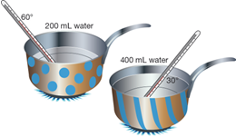
Question 2
200 mL of cold water is heated in a spotted saucepan, and 400 mL of cold water is heated in an identical striped saucepan.
Propose why the base of each saucepan is metal, but the handles are made from a tough plastic.
The metal will conduct heat and the plastic will insulate – stop heat moving through (or burning) the hand
Explain why the water in the spotty saucepan heats up faster.
The spotty saucepan contains less water (200 mL). This means the molecules will heat up more quickly, making the temperature higher
Compare the average kinetic energy of particles in each saucepan.
The spotty saucepan has less water and therefore fewer particles meaning each particle will absorb more kinetic energy. The stripy saucepan has more particles so each will absorb less kinetic energy.

Slide 8
Question 3
Explain the difference between opaque and transparent objects.
Opaque – light is either reflected/absorbed into the substance and no light is transmitted
Transparent almost all of the light is transmitted through the substance – it is clear / see through

Slide 9
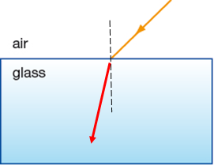
Question 4
The diagram below shows a light ray travelling through air to the interface between the air and a glass block.
On the diagram, draw and label the normal and a possible path for the ray in the glass.

Slide 10
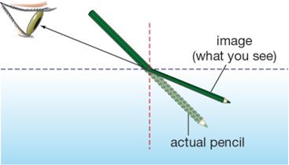
Question 5
The diagram below shows a pencil placed in water. The pencil appears bent when viewed from the air.
Complete the diagram by drawing the position of the image of the pencil as seen by the viewer.
Why does the pencil appear bent?
Refraction – the bending of light rays as light moves from air to water ---- rays bend away from the normal

Slide 11
Question 6
Function | Labelled part
Part of the outer ear it funnels sound into the ear canal | Pinna
Fluid filled chamber which passes vibrations on to tiny hair receptors | Cochlea
Joins middle ear – Enables balance of pressure due to air movement | Eustachian Tube
Large flap stretched tight across inside of ear -- sound reaching this makes it vibrate | Eardrum
Tiny bone which transmits vibrations to cochlea | Stapes

Slide 12
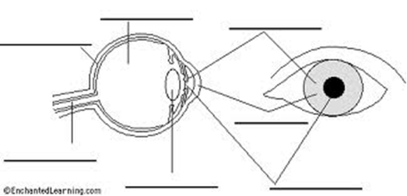
Question 7
A Retina
B Aqueous Humour
C Iris
D Optic Nerve
E Cornea
F Lens
G Pupil

Slide 13
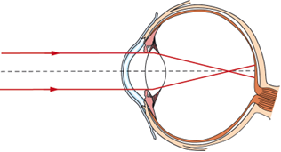
Question 8
This diagram shows how Hannah’s eye focuses light.
Identify Hannah’s vision problem.
Myopia --- Short sighted
What type of lens could be used to help Hannah see clearly.
Concave lens will focus image on retina

Slide 14
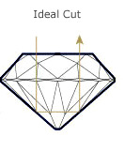
Question 9
This diagram shows a light ray moving through a diamond.
Why is the light ray being reflected back towards the direction it came from?
Total Internal reflection – inside the diamond

